Slide 1

RRSA
Rights Respecting School Award
Supporting pupils to become respectful global citizens
2026 Update for parents

Slide 2
What’s it all about?
As you may know, we work with UNICEF as part of the Rights Respecting School program. Over many years we have worked through the bronze, silver and gold levels of the award, and are very proud to be one of only a handful of schools in Kent to have achieved Gold RRSA level.
The award recognises achievement in putting the UN Convention on the Rights of the Child (UNCRC) at the heart of school life, to improve well-being and outcomes for every child and to help all children realise their potential.
Notes:
Please explain that:
The award is based on principles of equality, dignity, respect, non-discrimination and participation. The programme started in a pilot phase in 2006. Schools involved in the Award have reported a positive impact on relationships and well-being, leading to better learning and relationships, improved academic achievement and a reduction in bullying. It complements and adds to other school improvement strategies and interventions.
The Award is aimed at schools across the UK. We currently work with 5,000 primary and secondary schools and schools for children with special educational needs. plus pupil referral units. across England, Northern Ireland, Scotland and Wales. Schools need to register with us to take part in the programme.
RRSA is widely being recognised by head teacher’s and senior leaders a contributing significantly to school improvement.

Slide 3
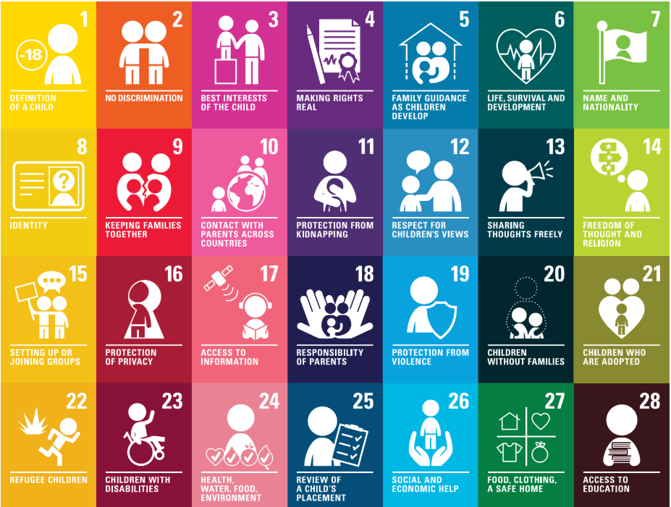
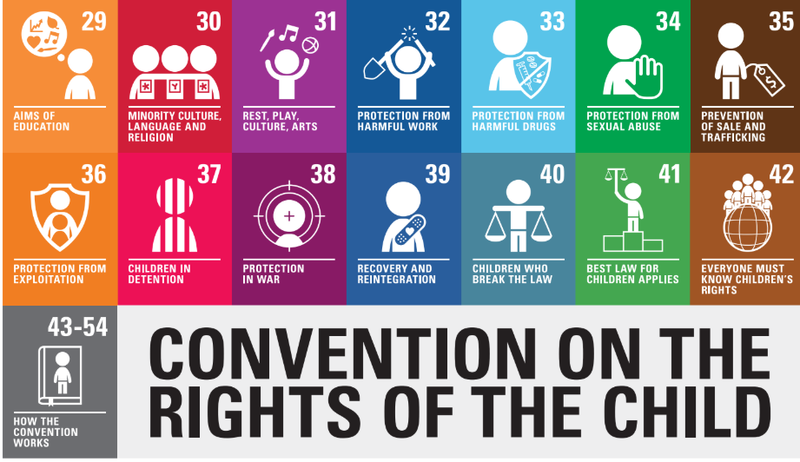
This is the UN Convention on the Rights of the Child, which lists children’s rights.
Governors, parents and school staff are duty bearers – we enable our children to receive their rights.
.

Slide 4
What does this look like in school?
RRSA Steering Group- Mrs Kitchen, Mrs Drew, a rep from each class from Year 2 – 6. (Year 1 join us in the summer term.) We hold regular meetings and act as liaisons with our classes and staff groups.
Our RRSA team are responsible for:
Leading assemblies about Unicef, children’s rights and our contribution as global citizens
Organising or promoting fundraising events, including Children in Need, Red Nose day, Harvest festival.
Leading on resource collection for our link school in Chipoka 2, Malawi.
Role modelling respectful attitudes to everyone
Checking that every class has a meaningful class charter
Creating displays around the school and making links between displays and UNCRC articles.
Conducting questionnaires to gain insight into pupils’ views and understanding of children’s rights
Supporting the gold action plan in preparation for accreditation

Slide 5

We have chosen an Article of the Month for each month to enable us to explore key articles more deeply in assemblies led by Mrs Kitchen and Mr Hutchins. These are shared with all parents on the year group newsletters and head teacher newsletters.
For example: Article 28
All children have the right to education.

Slide 6
What does this look like in school?
Our whole school initiatives are influenced by the rights of our children.
For example, this year we have introduced:
OPAL – Article 31 Every child has the right to relax and play
Read write inc phonics and Mastering Number KS1 schemes: Article 29 Children’s education should help them fully develop their personalities, talents and abilities.
Our new Eco Club led by Mrs Wilson and Mrs Rathbone: Article 29, Education must teach children to respect the environment.
Our school lunches and breakfast club support Article 24: Children have the right to the clean water and nutritious food.
Our Restorative approach to behaviour supports the concept of Dignity, which is a key concept in the Award.

Slide 7



  We are half way through our Outright campaign for 2026.
  We are learning about International Aid and how it enables children around the world to receive key rights.
© UNICEF/Al-Safadi
© UNICEF/Maule-Ffinch

Slide 8
Thank you

